Slide 1


Oh my CRUD Project 2
Jabaran Khan

Slide 2

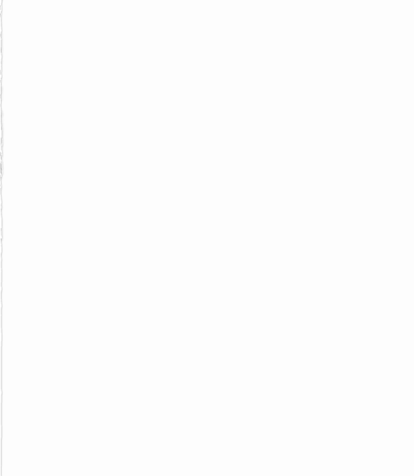
In this presentation we will cover:
The initial design of the project
What technologies will be covered?
Timeline to anticipate for project
Potential Risks
Project Management
Building the project
Code Snippets/Testing
Live Demo
Review
Closing

Slide 3
The initial design of the project
The initial design of the project was to make a full stack OOP-based web application. This has to be done within a working week. The application is meant to have basic CRUD functionality that the front-end and back-end could talk to each other in order to make a webpage.
After quite a lot of thought and my initials hesitation with the project I decided that I would make a simple to-do list product that tracks tasks and can create lists.

Slide 4
What technologies will be covered?
GitHub
Jira - Project Management
SpringBoot – IDE - End
Java, Maven - Build Tool – Back End
HTML, CSS, Javascript - Front End Source Code
JUnit, Mockito, Selenium - Testing
MySQL - Relational Database Language
SonarQube - Static Analysis (If possible)
Postman - assisted the API development

Slide 5
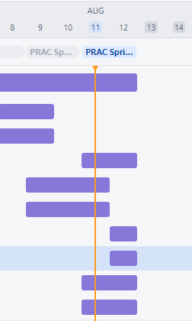
Timeline to anticipate for project
As this project was only a working week long I had to anticipate and use my time wisely and attempt. My biggest weakness during project 1 was my testing as I feel like I didn’t test enough. I wanted that to be my main focus. I created a timeline on Jira on what to do and create sprints to manage my time accordingly. I mainly used sprints to pace myself accordingly and hopefully get the work completed.
This was good to plan and update accordingly when I had a chance.

Slide 6
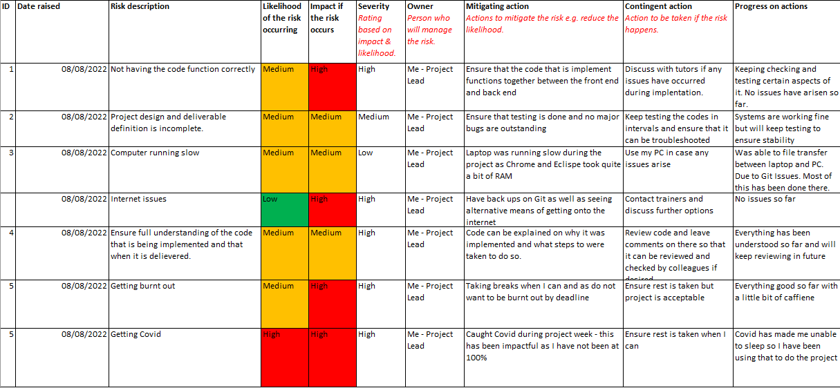
Potential Risks
Here is the potential risks that might have occurred during the project
The biggest external risks I had during this project was my laptop running slow due to IDE and Chrome. The next one was catching COVID-19 during project week. This has caused hurdles in my work.

Slide 7
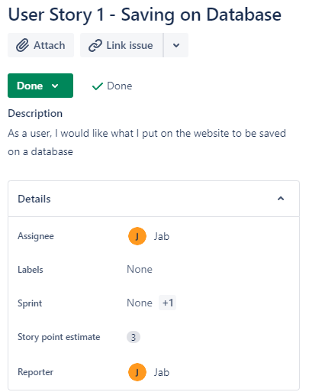

Project Management - Jira
Another one of my weakest subjects in the previous project was keeping on top of Jira. This time I added user stories as well as topics for myself to determine the range of the difficulty of the task. Story points helped in this regard.
Additionally I created issues that I raised myself so I could get used to this on the development side.

Slide 8
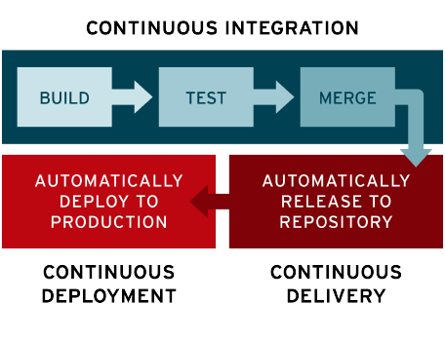
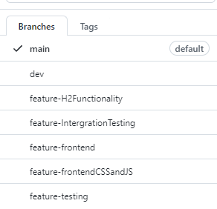
Project Management - Git
Using Git I wanted to follow the CI/CD model. Where I release substantial builds of the project upon completion of a major task. This allowed me to use a developer frame of mind, as well as when working on team projects we can share the repository. I’m still developing this frame of mind but hopefully it becomes natural.
Another component that I was lacking in the previous project was naming my git repositories correctly. I have now started to name accordingly on feature branch and following the FBM. This will allow people to see each update accordingly.

Slide 9
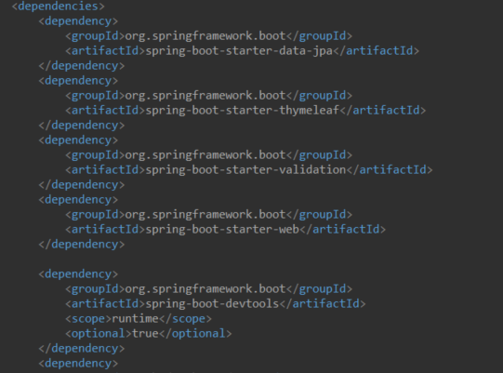
Dependencies - Maven
Firstly I had to ensure that the dependencies and the classes that I was creating worked with each other ensured that everything ran.
Everything did but I had to rollback a few things to get some stuff working – unfortunately I wasn’t able to get Swagger working in the timeframe.
I had to ensure that the POM file was updated when I needed to use other dependencies.

Slide 10
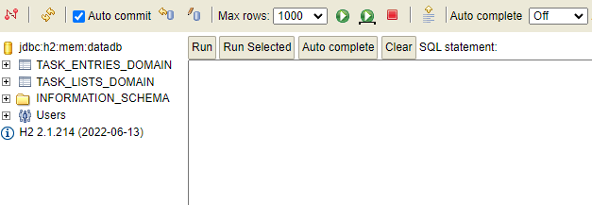
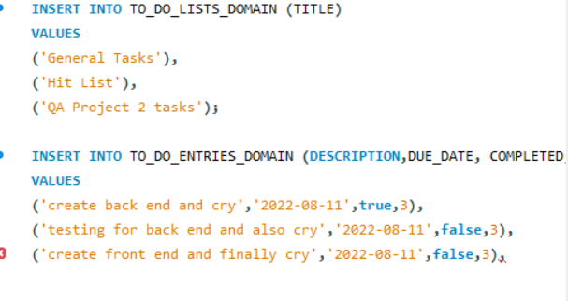
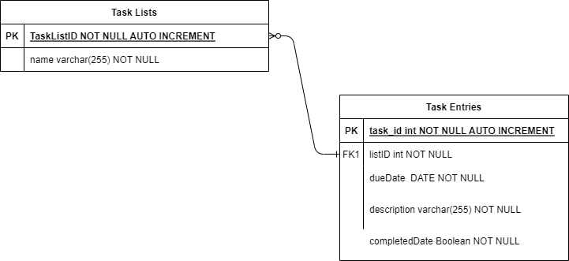
Building the project – MySQL/H2
H2 was new to me in this development as it something that I have never heard of. However it was a useful tool in testing as you didn’t need to tinker with SQL to get a database running. Additionally you can see the ERD that was used in the final project. I initially wanted 3 for a completion table but was unable to do this.

Slide 11
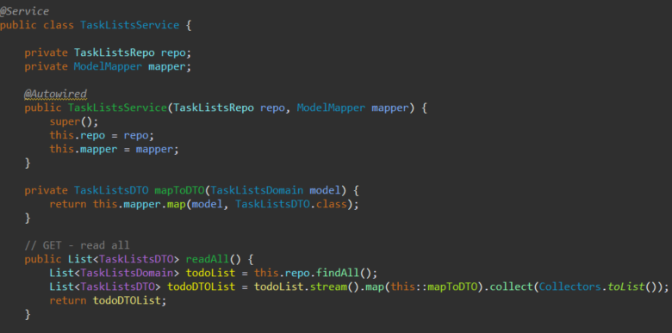
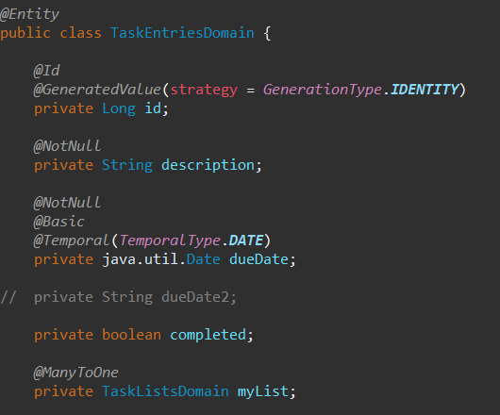
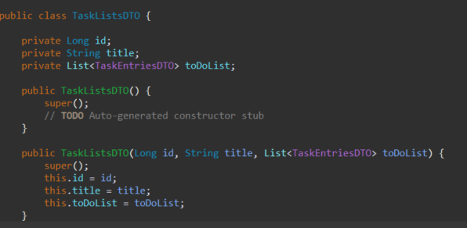

Using Spring to build the API in the back end
Service
Most of this went smoothly as it was similar to previous project but had to get used to Spring and how it works
Domain
Controller
DTO

Slide 12
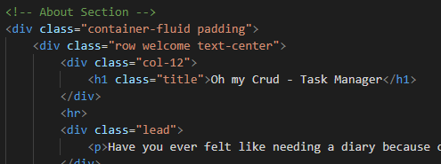
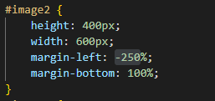
Building the Front End- HTML and CSS
The Front-end was new to me and was a challenging process as it wasn’t covered much but was essential to get the API working with the front-end and back-end.
I had to determine whether to use JS or Thymeleaf (Thymeleaf could in theory speak to the back-end and produce data) however I wasn’t able to get it working so went with JS to speak to the backend

Slide 13
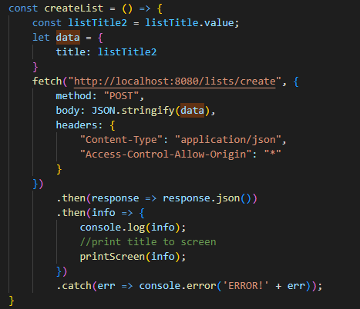

Using JavaScript and Bootstrap
JS was used for the CRUD functionality on the front-end. It was quite difficult to get right as I had some issues connecting to the back-end. However fetch requests and query selector worked out in the end and I could speak to the back-end locally.
With Bootstrap, I am new to it but it seemed like a useful tool. Mainly because it already has pre-determined buttons implement and all you needed to do was call it in HTML.

Slide 14
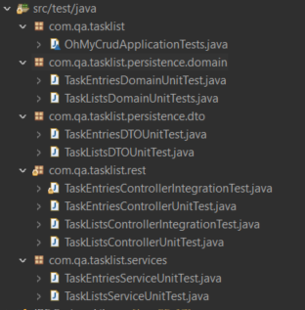
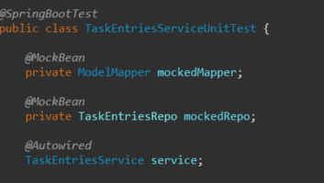
Testing – Unit Tests
The main focus what I wanted to achieve was getting testing right as that was something I felt could be improved. I used Unit Tests to test individual units of code and see if it works as intended. Mockito was used primarily for testing as it is good at creating mock interfaces

Slide 15
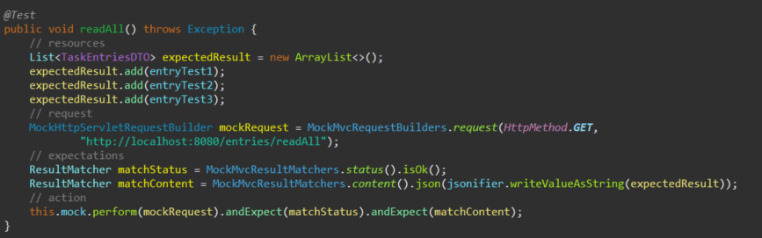
Testing – Integration Test
I was also able to do Integration testing – this is useful to make sure that the classes that communicate behave in the way we expect. It’s a good way to test the relationship between classes. The debug console is actually pretty useful to pick up on something that you might have changed as I was caught out numerous times on mistakenly changing a value.

Slide 16
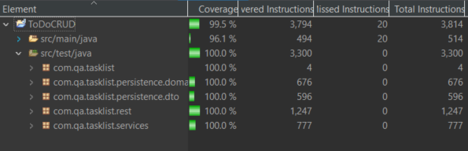
Testing
I managed to do quite a lot of coverage with the testing to ensure the project runs smoothly. This is good as testing was one of the areas that I want to develop on.
Unfortunately, at time of writing. I have not gotten Selenium running correctly yet. I will try and work into this more and hopefully get it working.

Slide 17
Live Demo
I will now show a live demo on how my project works. Hopefully it works!

Slide 18
Review
This project was pretty intense and seems to have wanted a lot from us however the things that I took away from this project was:
Positives:
-Trying to manage my time despite my circumstances
-Working on tasks
-Majority of testing done
-Used new languages and concepts that I haven’t used before joining QA
Things that didn’t go so well:
-Try and not to get Covid on project week
-Trying to understand why some applications weren’t working during project
-Selenium
-Cleaning up code and getting some functions workings correctly.

Slide 19
Closing
Thank you for your time and patience. You can now ask any questions.

